Slide 1
BIBFRAME at the Library of Congress
CEAL Committee on Technical Processing
March 22, 2018
Jodi Williamschen, Library of Congress

Slide 2
Preparation
Data model and vocabulary revised from BIBFRAME 1.0 to BIBFRAME 2.0
New MARC-to-BIBFRAME data conversion specifications and conversion software
New BIBFRAME search interface
Updated BIBFRAME editor capabilities
Infrastructure improvements
Additional servers
Update to database software and triplestore (MarkLogic)

Slide 3
Data conversion
18 million MARC bibliographic records from ILS database converted to BIBFRAME Works, Instances, and Items
1.2 million uniform title and name-title authority records converted to BIBFRAME Works
Created
19 million BIBFRAME Work descriptions
23 million BIBFRAME Instance descriptions
4 billion triples
Notes:
Mention differences between RDA w/e/m/i and BF w/i/i

Slide 4
Ongoing data processing
MARC bibliographic records from the Library’s ILS database are converted to BIBFRAME daily and added to the database
Title and name-title MARC authority records are converted to BIBFRAME Works daily and added to the database
Continuous matching and merging of new data to existing BIBFRAME work descriptions
Match: Discover all the Instances (manifestations) for a Work
Merge: Merge subjects and other Work information from instances and add them to existing Work description
Or create a new Work when none exists
Notes:
The database is not frozen. Records are added daily.

Slide 5
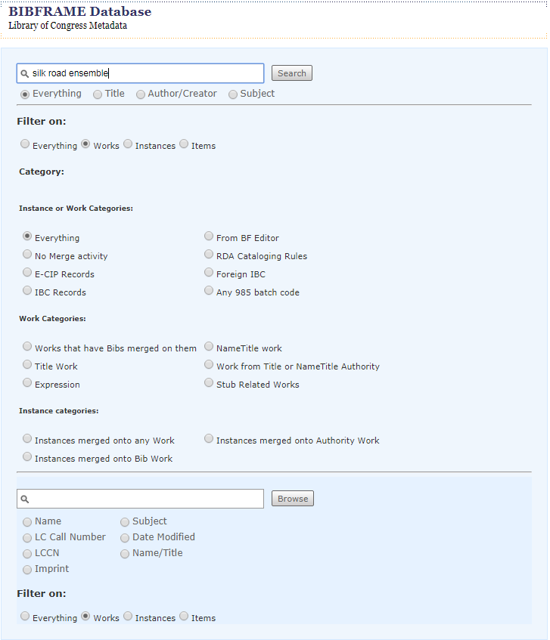
BIBFRAME database
Notes:
Internal to LC only for access; designed to be a cataloger’s tool and not a discovery interface. It’s a keyword search.

Slide 6
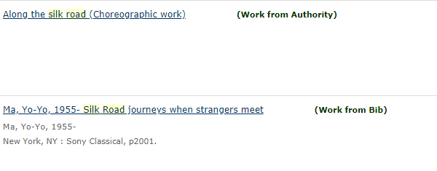
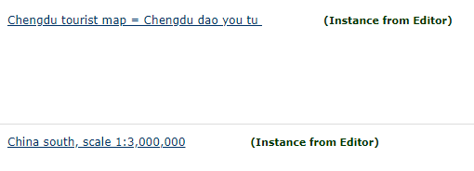
Notes:
There are markers in the display to tell us the source of the information. Work from Authority = converted from MARC title or name-title authority record. Work from Bib = converted from MARC bibliographic record. Work from Editor = native BIBFRAME

Slide 7
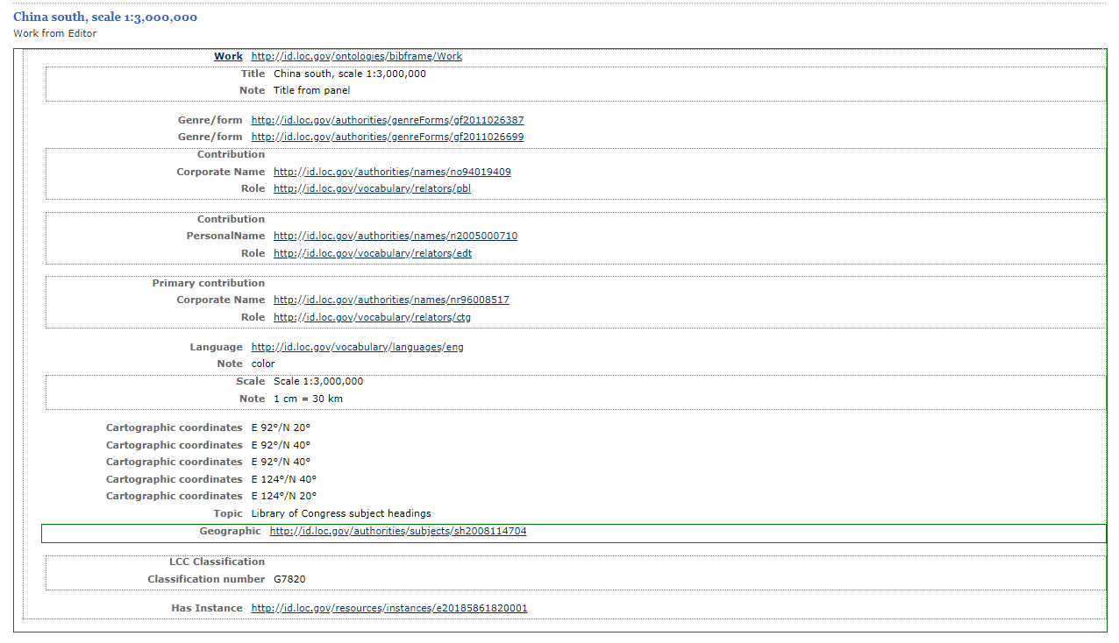
Notes:
Here’s the work record with lots of URLs and not many labels. It’s a cataloger/developer tool and a real discovery interface probably wouldn’t show the URLs – you would see text like “maps” or “tourist maps” instead

Slide 8
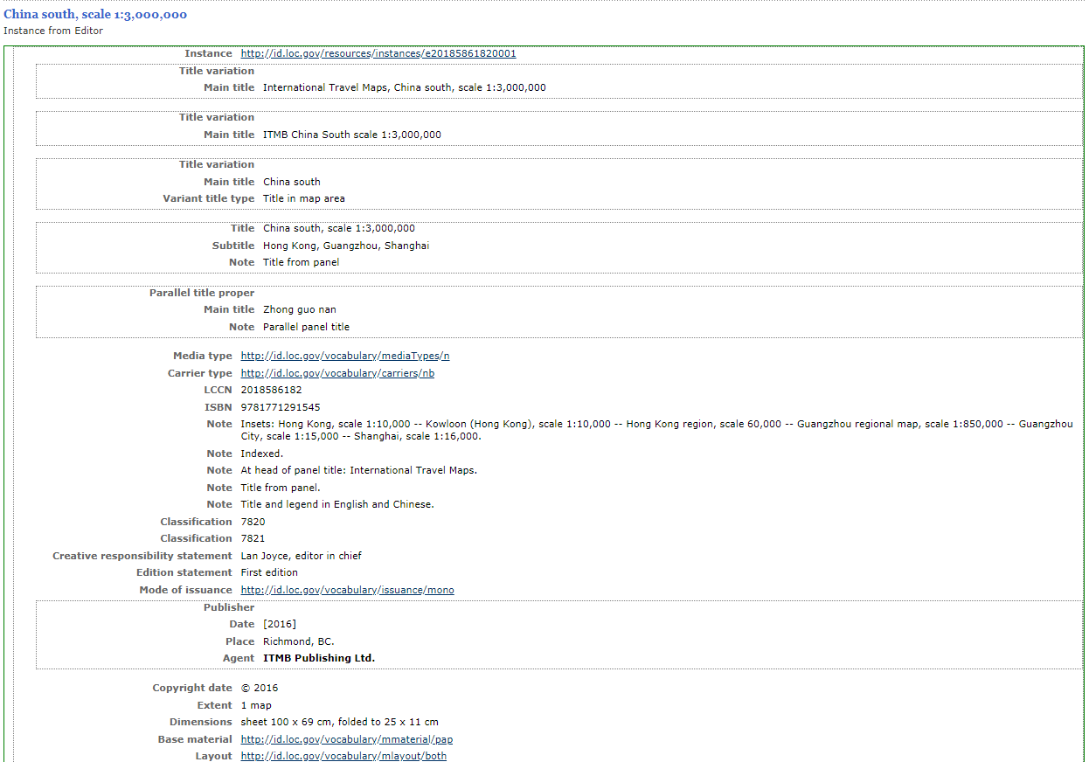
Notes:
This is the instance of the work record from the previous screen

Slide 9
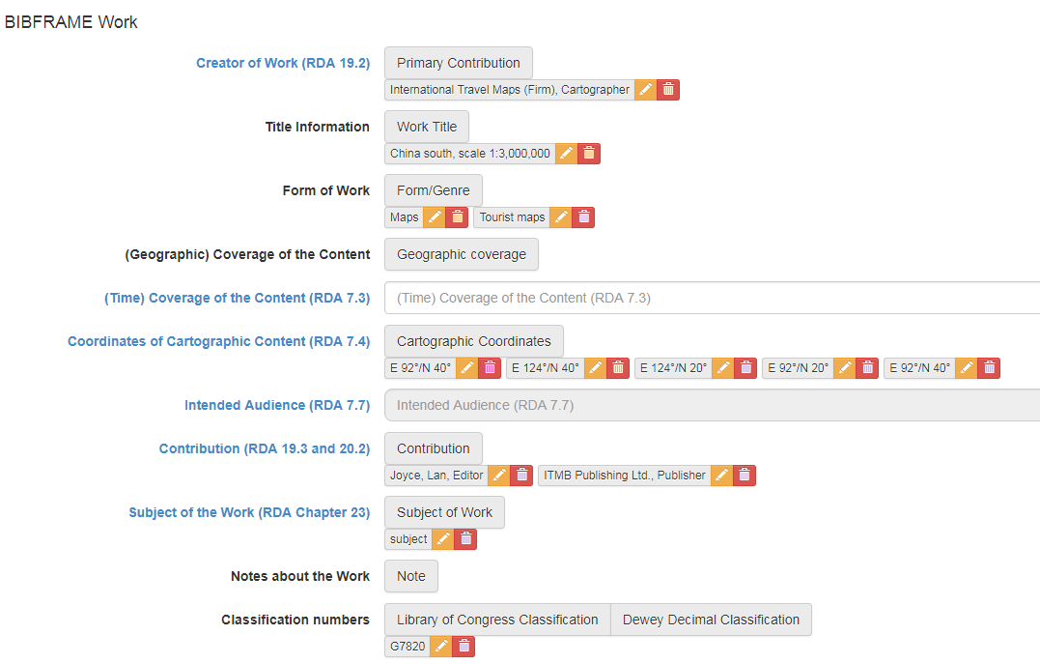
Notes:
Here is the same record as input in the BIBFRAME editor. This is most of the BF work elements

Slide 10
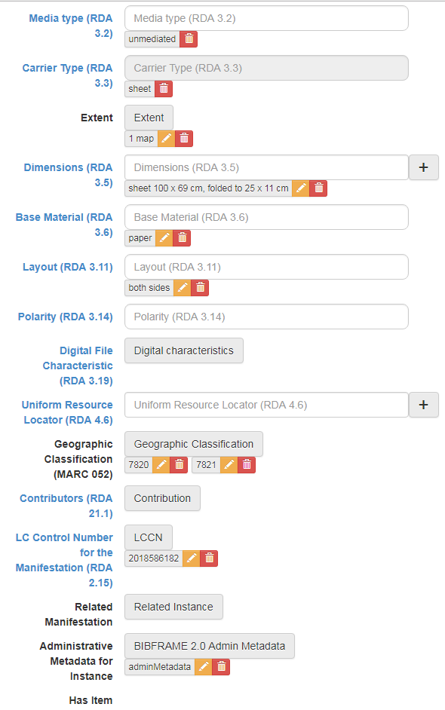
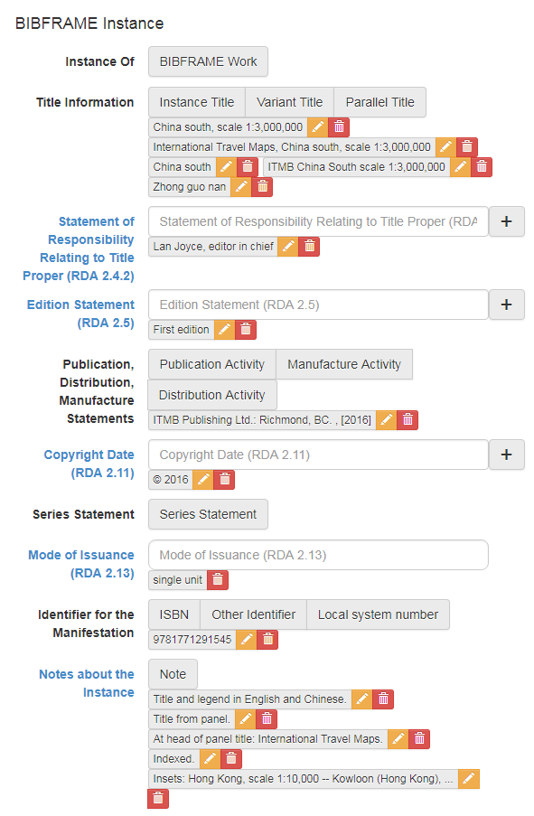
Notes:
This is the entire instance

Slide 11
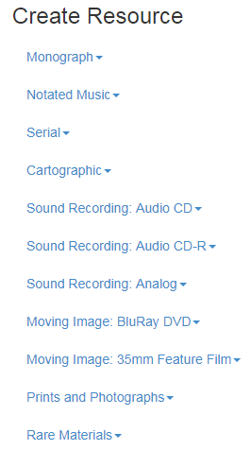
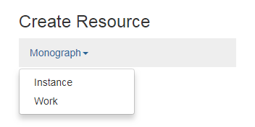
BIBFRAME editor
Notes:
Currently, we have created these format-specific profiles for cataloging in BIBFRAME
Under each, you can choose to start with the creation of an instance or a work

Slide 12
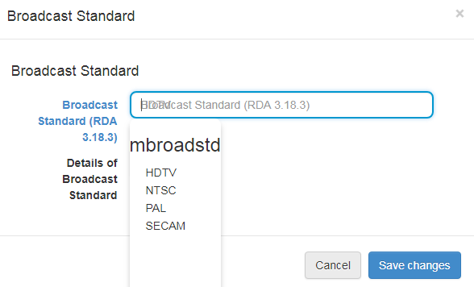
BIBFRAME editor
Notes:
Here are some examples of the use of drop-down vocabularies in the editor
The language list is the existing MARC language list from id.loc.gov
Broadcast standard is a part of the DVD profile. This is a list of terms from the RDA Registry that were added to id.loc.gov for the pilot.

Slide 13
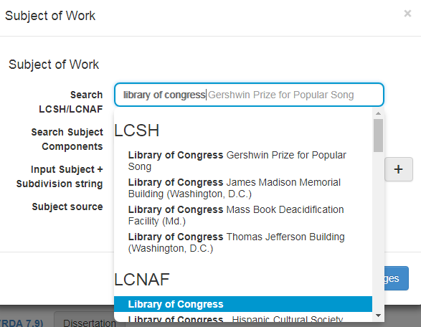
BIBFRAME editor
Notes:
Here is a subject search. The editor searches LCSH and the LC name authority file at the same time

Slide 14
What’s next?
Continue to evaluate and adjust the matching and merging of data in the BIBFRAME database
Continue to adjust BIBFRAME editor profiles to meet the needs of the catalogers and to include upcoming RDA 3R changes
Updated data conversion specifications
Offer download of LC’s BIBFRAME file for others to explore
Mapping from BIBFRAME to MARC

Slide 15
Resources
See how a MARC record looks in BIBFRAME RDF
http://id.loc.gov/tools/bibframe/compare

Slide 16
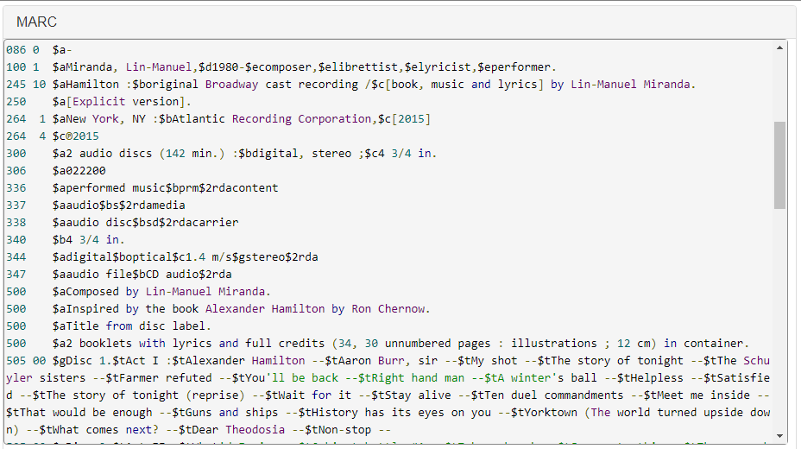
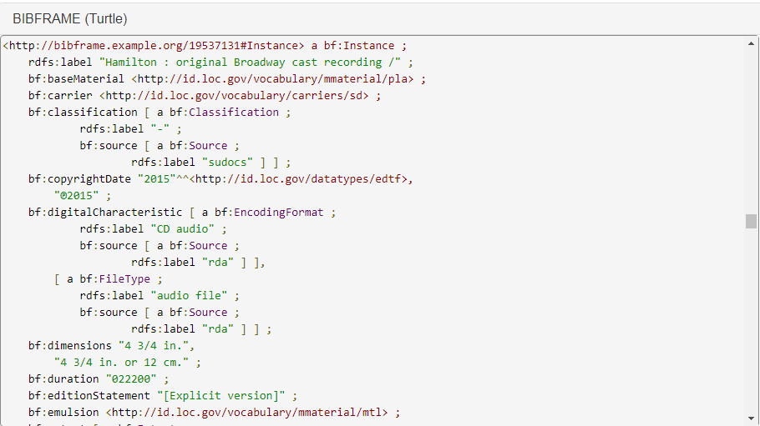
Notes:
MARC tag 347 $a becomes BF property digitalCharacteristic and class FileType; $b is class EncodingFormat

Slide 17
Resources
Components available for the community to explore
BIBFRAME vocabulary
http://www.loc.gov/bibframe/docs/index.html
MARC to BIBFRAME conversion specifications (Bib and Authority-title)
http://www.loc.gov/bibframe/mtbf
MARC to BIBFRAME conversion programs (Bib and Authority-title)
https://github.com/lcnetdev/marc2bibframe2
MARC to BIBFRAME comparison viewer (Bib and Authority-title)
http://id.loc.gov/tools/bibframe/compare

Slide 18
Thank you
Jodi Williamschen
Network Development and MARC Standards Office
Library of Congress
jowill@loc.gov

